Slide 1
Markov Decision Process project-3
Christian M. Adriano (Chris)
christian.adriano@hpi.de
Notes:
https://en.wikipedia.org/wiki/Transduction_(machine_learning)

Slide 2
Topics
Review of MDP Learning Algorithms
Concepts
Model-based algorithms (Value or Policy iteration)
Model-free algorithms (Sarsa and Q-Learning)
Project description
Tool – Environment + Agent

Slide 3
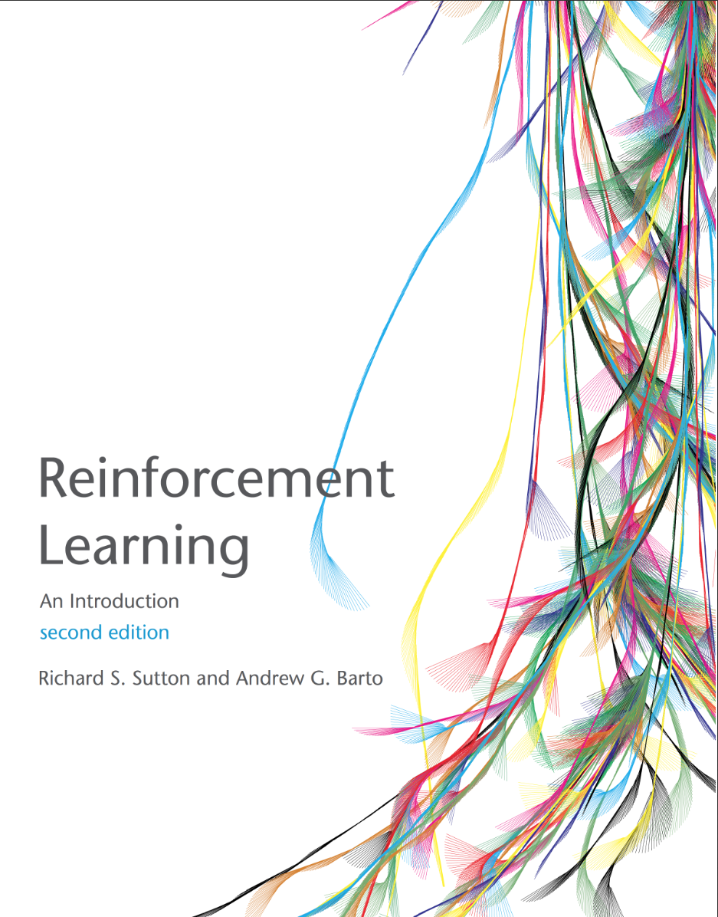
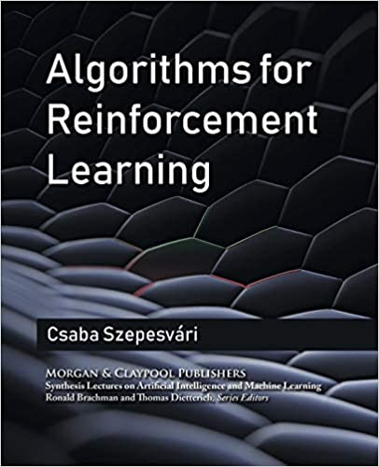
Textbooks (free access)
Sutton, R. S., & Barto, A. G. (2015). Reinforcement learning: An introduction. MIT press.
free access at the author’s page: http://richsutton.com
Csaba Szepesvári (2010). Algorithms for reinforcement learning Morgan and Claypool.
free access by the authors’
https://sites.ualberta.ca/~szepesva/rlbook.html
Notes:
https://www.microsoft.com/en-us/research/blog/exploring-the-fundamentals-of-multi-armed-bandits/

Slide 4
Basic concepts - Structure
Agent: external to the environment, take actions and has access to external states
Environment: constrains the agent, has hidden and visible states
State: visible information about the environment after an action was taken
Reward: value obtained after taking an action or being at a state
Action: taken by an agent, might cause a change in state
Goal: Maximize rewards by using an optimal policy
Policy: set of state action pairs
Markov property: we only need to know the current state to predict the next state

Slide 5

Agent and Environment Interaction
Action
Agent
Environment
State
Reward
Agent’s Goal: Maximize its reward
Our Goal: Discover a strategy that allows the agent to achieve its goal under various circumstances
Search, Estimate, Learn
Policy = $π(S,A)$
knowlege about the environment

Slide 6
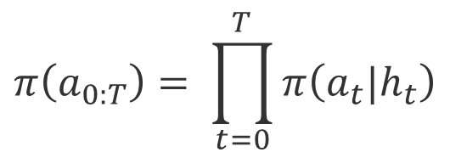
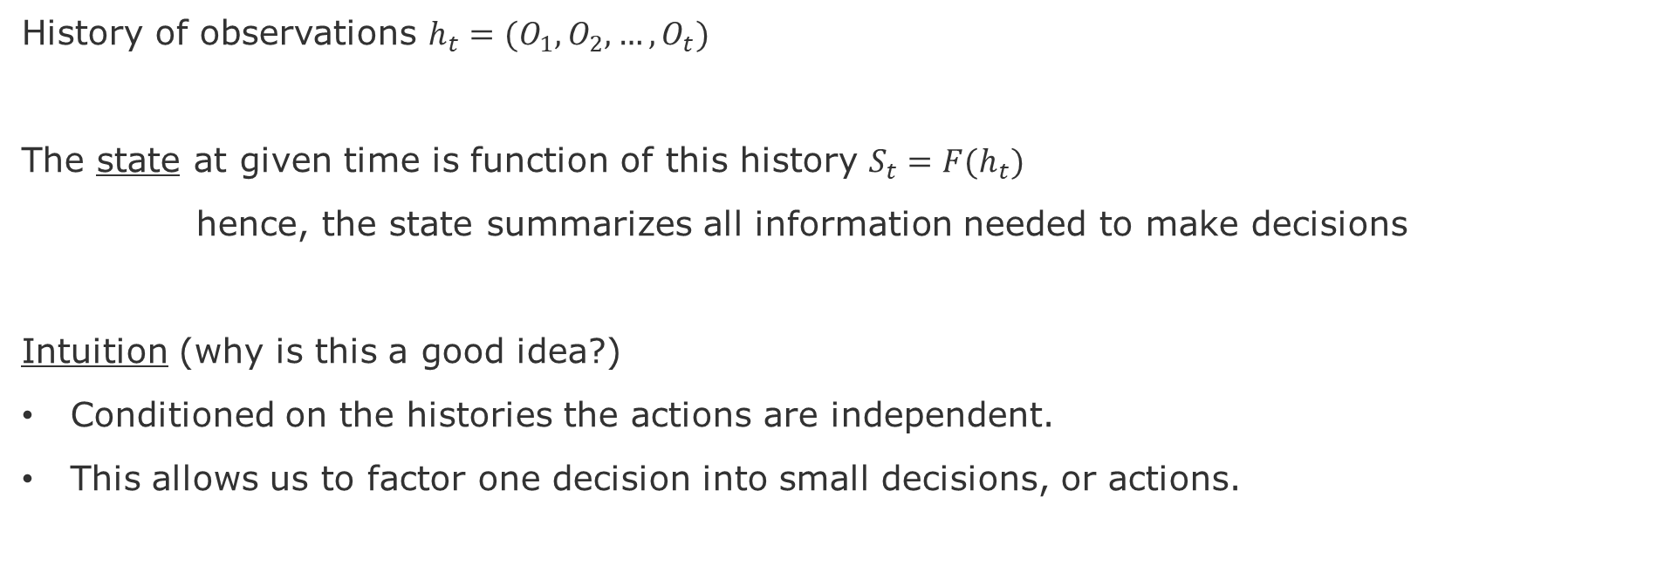
State
History of observations $h_{t}=(O_{1},O_{2}, …,O_{t})$
The state at given time is function of this history $S_{t}=F(h_{t})$
hence, the state summarizes all information needed to make decisions
Intuition (why is this a good idea?)
Conditioned on the histories the actions are independent.
This allows us to factor one decision into small decisions, or actions.
$$π\left(a_{0:T}\right)= \prod_{t=0}^{T}{π\left(a_{t}|h_{t}\right)}$$

Slide 7
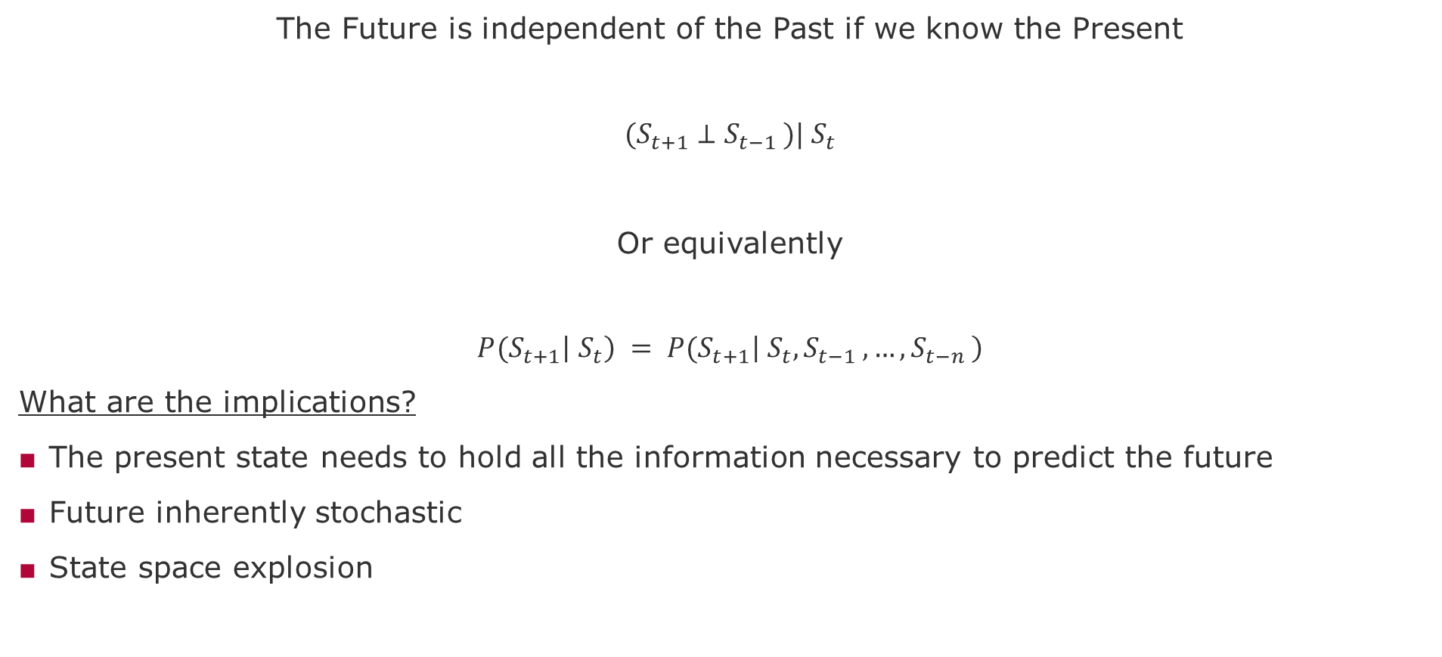
Markov Property
The Future is independent of the Past if we know the Present
$${(S}_{t+1} ⊥S_{t−1 })|{ S}_{t}$$
Or equivalently
$${P(S}_{t+1}\left|{ S}_{t}\right) = {P(S}_{t+1}\left|{ S}_{t},S_{t−1 },…,S_{t−n }\right)$$
What are the implications?
The present state needs to hold all the information necessary to predict the future
Future inherently stochastic
State space explosion

Slide 8


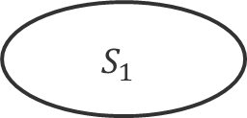


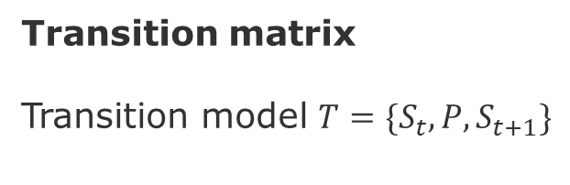

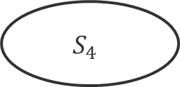


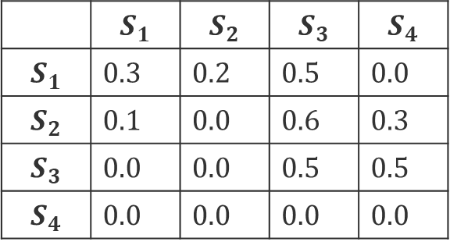




Markov Chain
Transition matrix
Transition model ${T=\{S}_{t},P,S_{t+1}\}$
$$0.3$$
$$0.5$$
$$S_{1}$$
$$0.5$$
$$S_{3}$$
 | $$S_{1}$$ | $$S_{2}$$ | $$S_{3}$$ | $$S_{4}$$
$$S_{1}$$ | 0.3 | 0.2 | 0.5 | 0.0
$$S_{2}$$ | 0.1 | 0.0 | 0.6 | 0.3
$$S_{3}$$ | 0.0 | 0.0 | 0.5 | 0.5
$$S_{4}$$ | 0.0 | 0.0 | 0.0 | 0.0
$$0.2$$
$$0.1$$
$$0.6$$
$$0.5$$
$$S_{2}$$
$$0.3$$
$$S_{4}$$
$$1.0$$
End
Problems of learning and planning
Problems of prediction and control

Slide 9
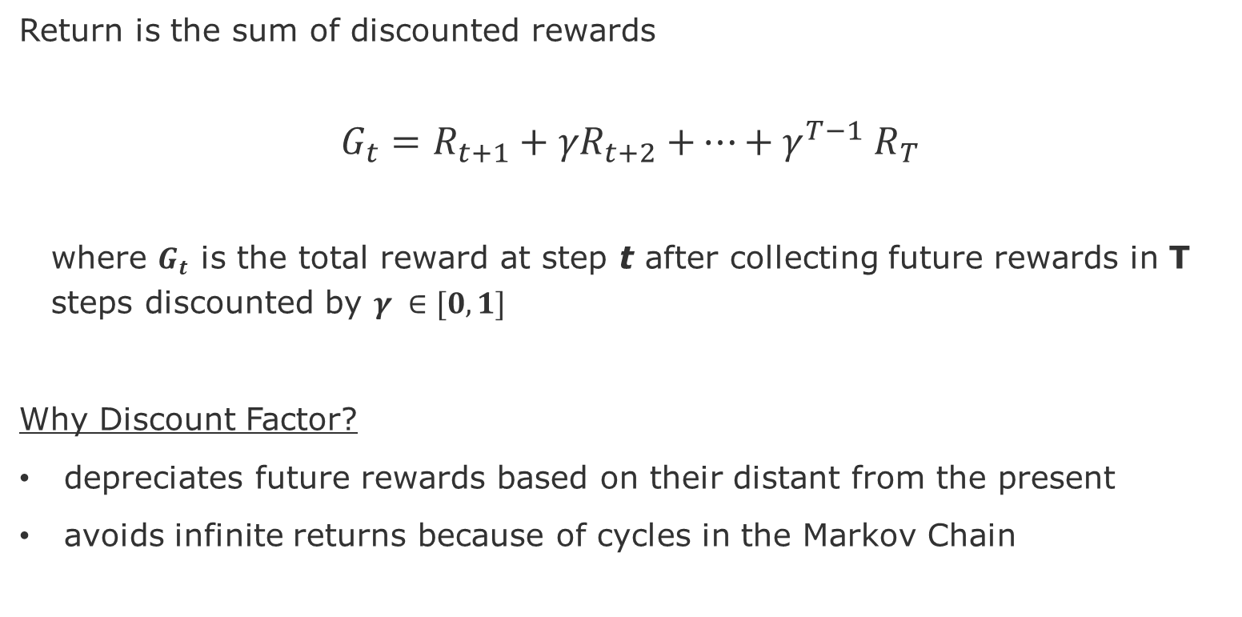
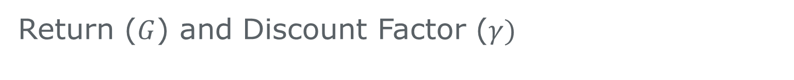
Return ($G$) and Discount Factor ($γ)$
Return is the sum of discounted rewards
$$G_{t}=R_{t+1}+{γR}_{t+2}{+…+γ}^{T−1}R_{T}$$
where $G_{t}$ is the total reward at step t after collecting future rewards in T steps discounted by $γ ∈[0,1]$
Why Discount Factor?
depreciates future rewards based on their distant from the present
avoids infinite returns because of cycles in the Markov Chain

Slide 10
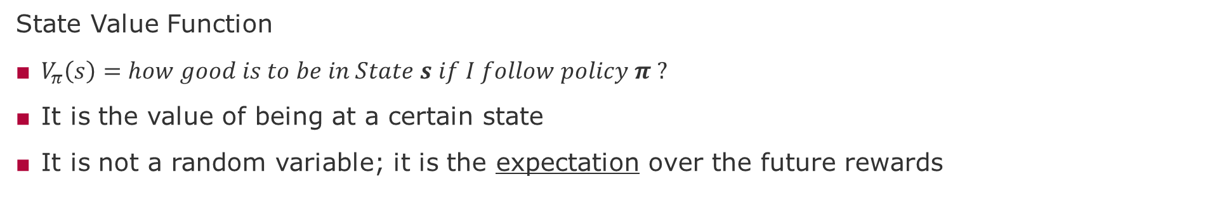
Value Function
State Value Function
$V_{π}\left(s\right)=how good is to be in State s if I follow policy π ?$
It is the value of being at a certain state
It is not a random variable; it is the expectation over the future rewards

Slide 11
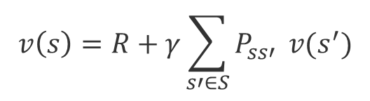




Bellman Equation
$$v(s)=E\left[R_{t+1}+γ.v\left(S_{t+1}\right) |{ S}_{t}=s\right]$$
$$v\left(s\right)←s$$
$$R$$
$$v\left(s′\right)←s′$$
One-Step Lookahead idea
$$v\left(s\right)=R+γ\sum_{s′∈S}{P_{ss′}} v(s^{′})$$

Slide 12

















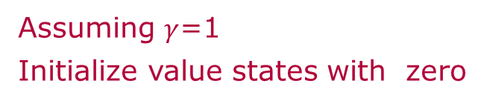








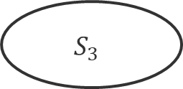
















Markov Reward Process (MRP)
$$0.3$$
$$R=−2$$
$$0.5$$
$$R=−2$$
$$0.3$$
$$R=−2$$
$$0.5$$
$$R=−2$$
$$S_{1}$$
$$0.5$$
$$S_{3}$$
$$S_{1}$$
$$0.5$$
0
$$R=−1$$
$$R=−1$$
$$0.2$$
$$0.1$$
$$0.6$$
$$0.5$$
$$R=4$$
$$0.2$$
$$0.1$$
$$0.6$$
$$0.5$$
$$R=4$$
$$R=−1$$
$$R=−1$$
$$R=1$$
$$R=−1$$
$$R=1$$
$$R=−1$$
$$S_{2}$$
$$0.3$$
$$S_{4}$$
$$1.0$$
$$S_{2}$$
$$0.3$$
20
$$1.0$$
End
End
$$R=2$$
$$R=2$$
$$R=0$$
$$R=0$$
Assuming $γ$=1
Initialize value states with zero
Value of $S_{3}$ = 4 + 20*0.5 -2 +0.5*0.0 =14

Slide 13


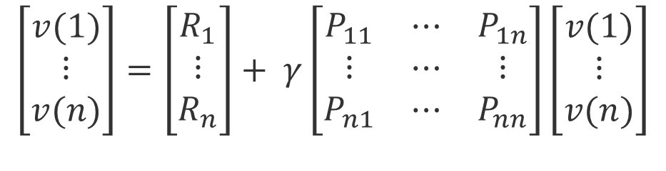
Bellman equation in matrix form
$$v=R+γPv$$
$$\left[\begin{matrix}v(1) \\ ⋮ \\ v(n)\end{matrix}\right]=\left[\begin{matrix}R_{1} \\ ⋮ \\ R_{n}\end{matrix}\right]+ γ\left[\begin{matrix}P_{11} & ⋯ & P_{1n} \\ ⋮ & ⋯ & ⋮ \\ P_{n1} & ⋯ & P_{nn}\end{matrix}\right]\left[\begin{matrix}v(1) \\ ⋮ \\ v(n)\end{matrix}\right]$$
$$v=(1− γPv)^{−1} R$$
Feasible for small number of states
Linear version of the Bellman Equation

Slide 14
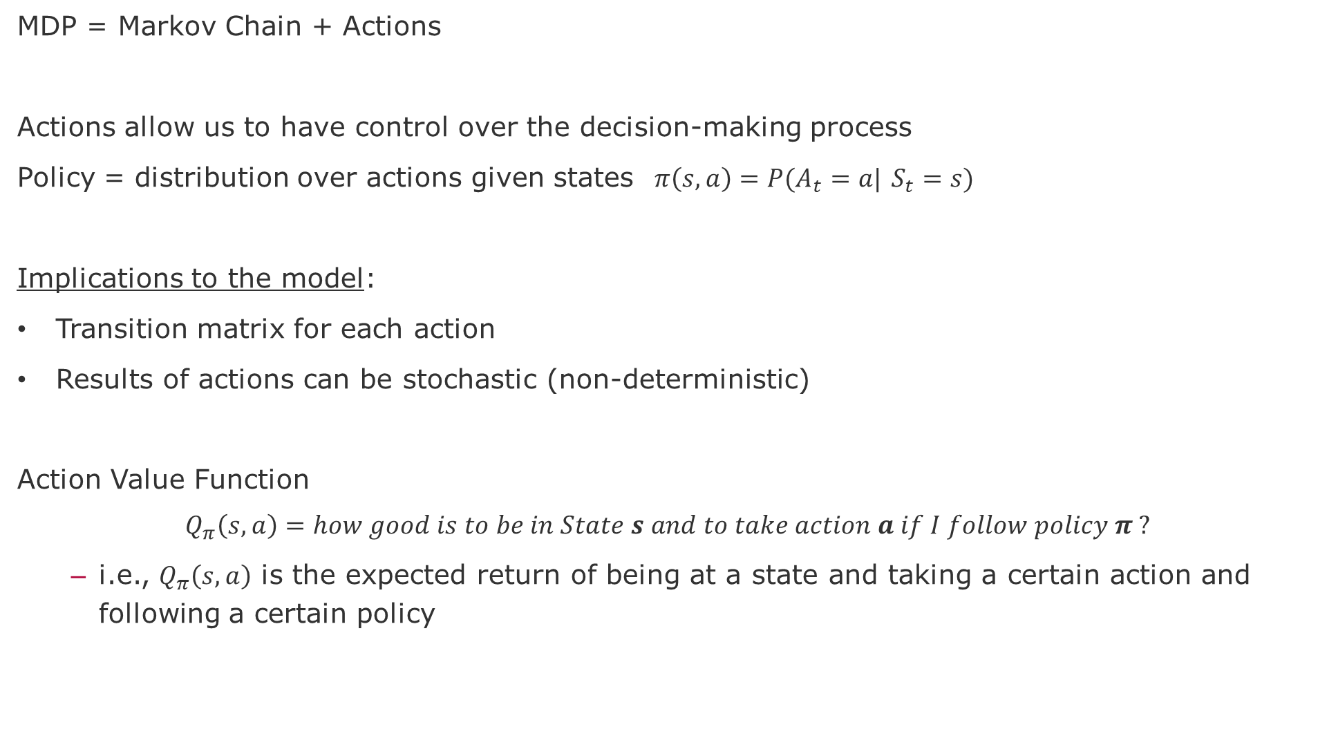
Markov Decision Process (MDP)
MDP = Markov Chain + Actions
Actions allow us to have control over the decision-making process
Policy = distribution over actions given states $π\left(s,a\right)=P(A_{t}=a|$ $S_{t}=s)$
Implications to the model:
Transition matrix for each action
Results of actions can be stochastic (non-deterministic)
Action Value Function
$$Q_{π}\left(s,a\right)=how good is to be in State s and to take action a if I follow policy π ?$$
i.e., $Q_{π}\left(s,a\right)$ is the expected return of being at a state and taking a certain action and following a certain policy

Slide 15
Bellman Optimatility Equation
How to find the best path in the MDP?
Bellman equation estimates V(s) by looking ahead of possible future trajectories in the state-space
Intuition
If we behave optimally for the first step and then also behave optimally for the next step, we will find the optimal solution for the MDP. However, note that to behave optimally I need to average over all possible paths that are opened by my first step.

Slide 16

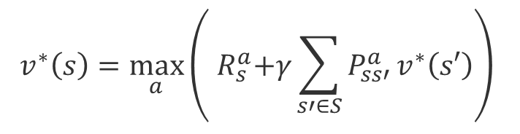






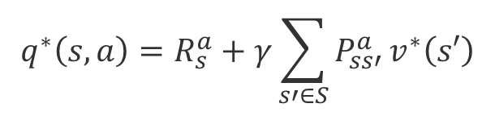




Bellman Optimality Equations for MDPs
$$v^{∗}\left(s\right)←s$$
$$v^{∗}\left(s\right)←s$$
$$R$$
$$q\left(s,a\right)←s,a$$
$$R$$
$$q^{∗}\left(s,a\right)←s,a$$
$$R$$
$$q^{∗}\left(s,a\right)←s,a$$
$$v^{∗}\left(s′\right)←s′$$
$$v^{∗}\left(s′\right)←s′$$
$$q^{∗}\left(s,a\right)=R_{s}^{a}+γ\sum_{s′∈S}{P_{ss′}^{a}}v^{∗}\left(s′\right)$$
$$v^{∗}\left(s\right)=\max_{a}{q^{∗}\left(s,a\right)}$$
$$v^{∗}\left(s\right)=\max_{a}\left({ R}_{s}^{a}+γ\sum_{s′∈S}{P_{ss′}^{a}}v^{∗}\left(s′\right)\right)$$
The value function of a state is the maximum that I can get after taking an action
The optimal value is the expected return of the multiple states we can end up after taking action a

Slide 17


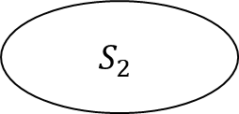







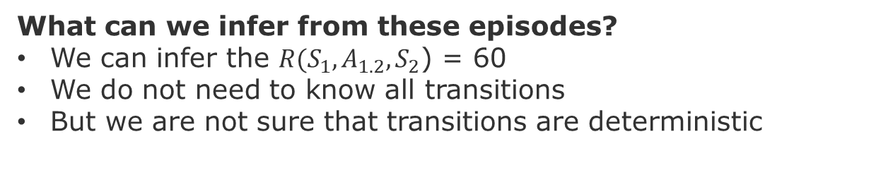



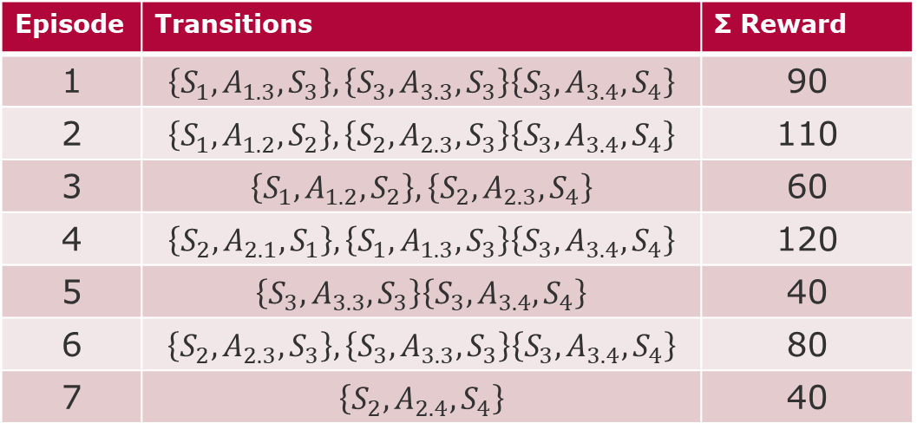
Episodes
$$A_{1.1}$$
$$A_{3.3}$$
Episode | Transitions | Σ Reward
1 | $$\left\{S_{1},A_{1.3},S_{3}\right\},\left\{S_{3},A_{3.3},S_{3}\right\}\left\{S_{3},A_{3.4},S_{4}\right\}$$ | 90
2 | $$\left\{S_{1},A_{1.2},S_{2}\right\},\left\{S_{2},A_{2.3},S_{3}\right\}\left\{S_{3},A_{3.4},S_{4}\right\}$$ | 110
3 | $$\left\{S_{1},A_{1.2},S_{2}\right\},\left\{S_{2},A_{2.3},S_{4}\right\}$$ | 60
4 | $$\left\{S_{2},A_{2.1},S_{1}\right\},\left\{S_{1},A_{1.3},S_{3}\right\}\left\{S_{3},A_{3.4},S_{4}\right\}$$ | 120
5 | $$\left\{S_{3},A_{3.3},S_{3}\right\}\left\{S_{3},A_{3.4},S_{4}\right\}$$ | 40
6 | $$\left\{S_{2},A_{2.3},S_{3}\right\},\left\{S_{3},A_{3.3},S_{3}\right\}\left\{S_{3},A_{3.4},S_{4}\right\}$$ | 80
7 | $$\left\{S_{2},A_{2.4},S_{4}\right\}$$ | 40
$$S_{1}$$
$$A_{1.3}$$
$$S_{3}$$
$$0.6$$
$$A_{1.2}$$
$$A_{2.1}$$
$$A_{3.4}$$
$$A_{2.3}$$
$$0.4$$
$$S_{2}$$
$$S_{4}$$
What can we infer from these episodes?
We can infer the ${R(S}_{1},A_{1.2},S_{2}$) = 60
We do not need to know all transitions
But we are not sure that transitions are deterministic

Slide 18
Model-Based Methods

Slide 19
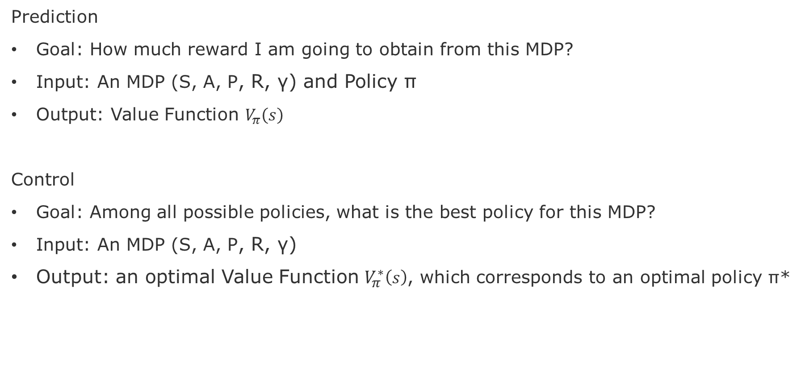
Prediction versus Control Problems
Prediction
Goal: How much reward I am going to obtain from this MDP?
Input: An MDP (S, A, P, R, γ) and Policy ϖ
Output: Value Function $V_{π}\left(s\right)$
Control
Goal: Among all possible policies, what is the best policy for this MDP?
Input: An MDP (S, A, P, R, γ)
Output: an optimal Value Function $V_{π}^{∗}\left(s\right)$, which corresponds to an optimal policy ϖ*
Control
For-loop:
Prediction

Slide 20
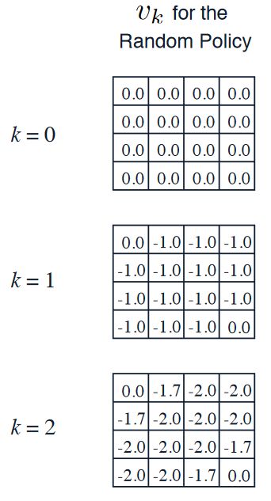
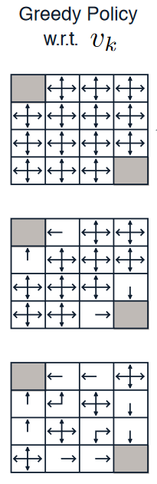


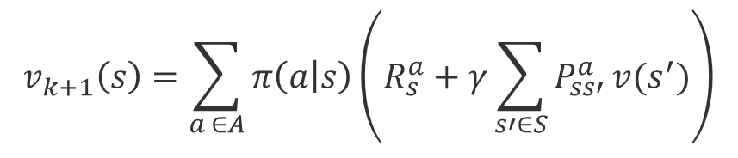




Policy Evaluation and Policy Iteration
$$v_{k+1}\left(s\right)←s$$
$$a$$
$$R$$
$$v\left(s′\right)←s′$$
One step lookahead
$$v_{k+1}\left(s\right)=\sum_{a ∈A}{π\left(a | s\right)\left(R_{s}^{a}+γ\sum_{s′∈S}{P_{ss′}^{a}}v(s^{′})\right)}$$
Evaluate:
$$v^{k+1}(s)=R^{π}+γP^{π}v^{k}$$
Improve:
$$π^{′}\left(s\right)=\max_{a ∈A}{q_{π}(s,a)}$$
Greedy!
Source: Silver, 2015, https://www.davidsilver.uk/wp-content/uploads/2020/03/DP.pdf

Slide 21
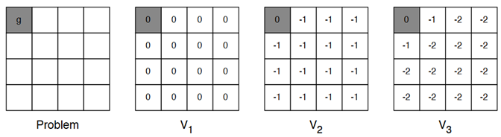
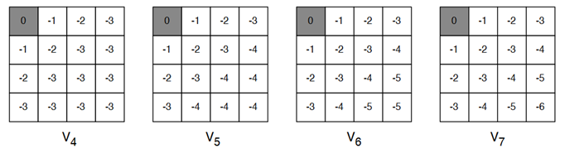
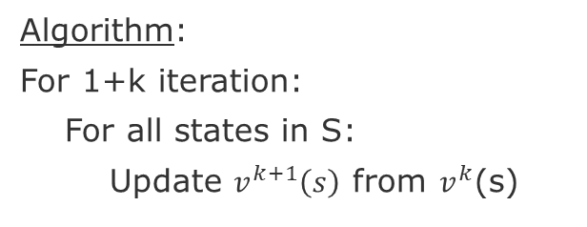


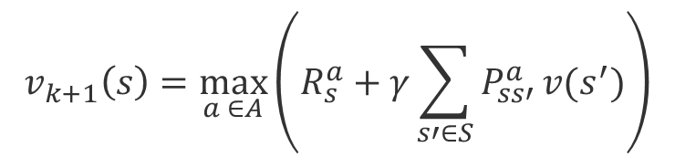



Value Iteration
$$v_{k+1}\left(s\right)←s$$
Algorithm:
For 1+k iteration:
For all states in S:
Update $v^{k+1}\left(s\right)$ from $v^{k}$(s)
$$a$$
$$R$$
$$v\left(s′\right)←s′$$
$$v_{k+1}\left(s\right)=\max_{a ∈A}\left(R_{s}^{a}+γ\sum_{s′∈S}{P_{ss′}^{a}}v(s^{′})\right)$$
$$v^{k+1}\left(s\right)=\max_{a ∈A}\left(R^{a}+γP^{a}v^{k}\right)$$
Source: Silver, 2015, https://www.davidsilver.uk/wp-content/uploads/2020/03/DP.pdf

Slide 22
Model-Free Prediction Methods

Slide 23
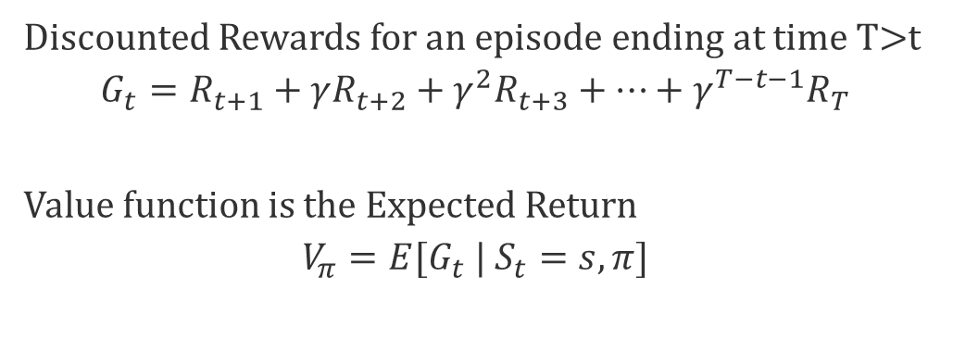
Monte Carlo Policy Evaluation
Sample the rewards for each action across multiple Episodes
Similar to what we have seen in the Multi-Armed Bandits
Discounted Rewards for an episode ending at time T>t
$$G_{t}=R_{t+1}+γR_{t+2}+{γ_{ }^{2}R}_{t+3}+…+{γ_{ }^{T−t−1}R}_{T}$$
Value function is the Expected Return
$$V_{π}=E{[G}_{t} | S_{t}=s,π]$$
Caveat: Multiple episodes necessary to update the state value function under a policy $V_{π}\left(S\right)$

Slide 24
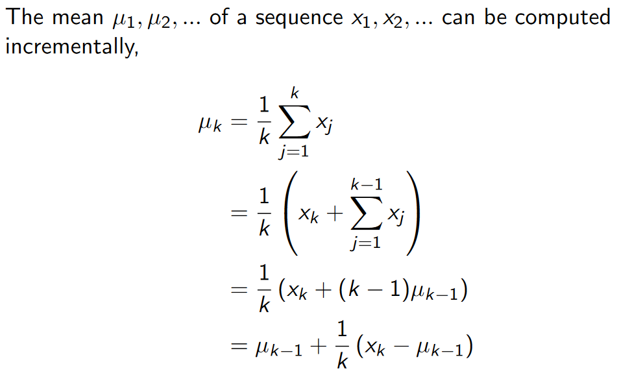
Incremental Mean
Source: Silver, 2015, https://www.davidsilver.uk/wp-content/uploads/2020/03/MC-TD.pdf

Slide 25
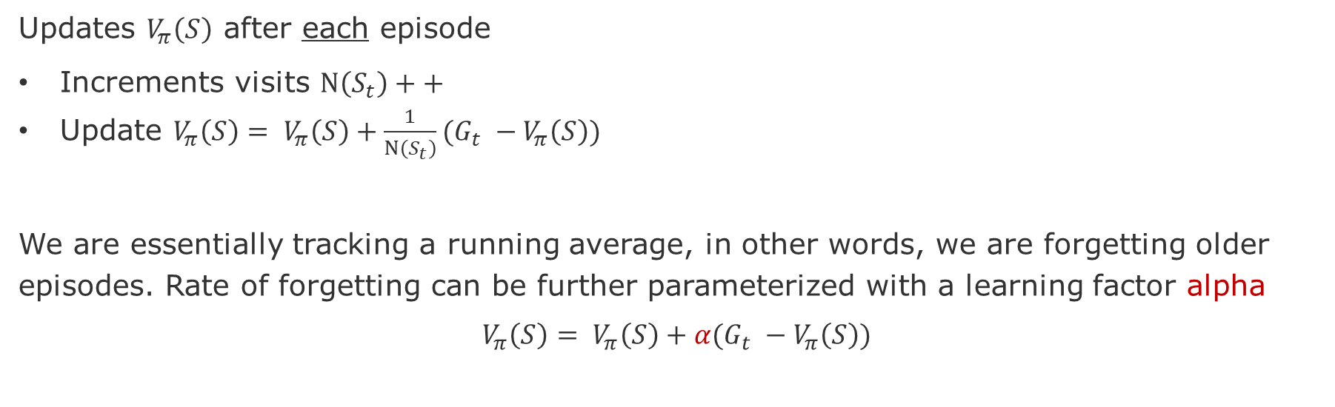
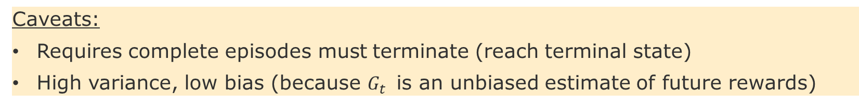
Incremental Monte Carlo Updates
Updates $V_{π}\left(S\right)$ after each episode
Increments visits $N\left(S_{t}\right)++$
Update $V_{π}\left(S\right)= V_{π}\left(S\right)+\frac{1}{N\left(S_{t}\right)}(G_{t} −V_{π}\left(S\right))$
We are essentially tracking a running average, in other words, we are forgetting older episodes. Rate of forgetting can be further parameterized with a learning factor alpha
$$V_{π}\left(S\right)= V_{π}\left(S\right)+α(G_{t} −V_{π}\left(S\right))$$
Advantages:
Non-stationary estimator
Memoryless algorithms
Caveats:
Requires complete episodes must terminate (reach terminal state)
High variance, low bias (because $G_{t}$ is an unbiased estimate of future rewards)

Slide 26


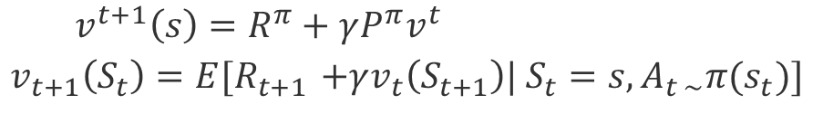
Temporal Difference Learning
Recalling Policy Iteration
$$v^{t+1}\left(s\right)=R^{π}+γP^{π}v^{t}$$
$$v_{t+1}\left(S_{t}\right)=E{[R}_{t+1 }+γv_{t}\left(S_{t+1}\right)| S_{t}=s,A_{t \sim }π{(s}_{t})]$$
Bootstrapping
Monte Carlo
TD Learning
TD-Error
Advantages:
Updates with partial episodes
Size of partial episode is parameterizable (lambda)
Caveat: High Bias, but less variance (because update depends on only one action)

Slide 27
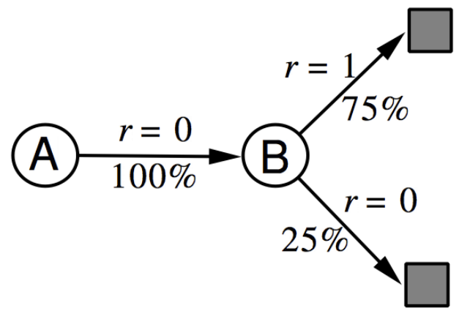
Batch Learning = Limited Budget
The batch dataset has 8 episodes with the following (state, return) values
Episode | Data
1 | (A,0), (B,0)
2 | (B,1)
3 | (B,1)
4 | (B,1)
5 | (B,1)
6 | (B,1)
7 | (B,1)
8 | (B,0)
What are the value function estimates for A and B?
Monte Carlo:
(A) = 0/8 = 0,
V(B) = 6/8 = 0.75
Temporal Difference:
V(A) = R(A) + [R(B) + V(B) - V(A)] = 0.75
V(B) = 0.75

Slide 28
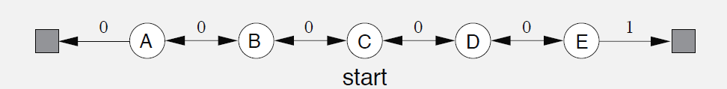
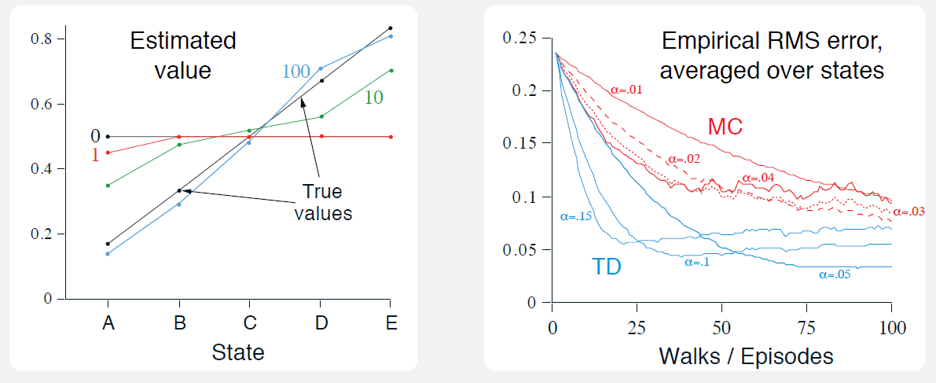
Temporal Difference (TD) vs Monte Carlo (MC)
source: page 125 [Sutton & Barto 2018]
Notes:
Left plot: TD learning approximate true value of the states (black line) after 100 steps.
Right plot:
RMSE – Root mean-squared error between the value function learned and the true value
function, averaged over the five states, then averaged over 100 runs.
Low step size in makes TD and MC error curves smoother, however it takes longer to drop. Both converge to the trur value, but MC is noisier (higher variance).
Larger step size makes TD approximate faster, but it stabilizes at a higher error level.

Slide 29
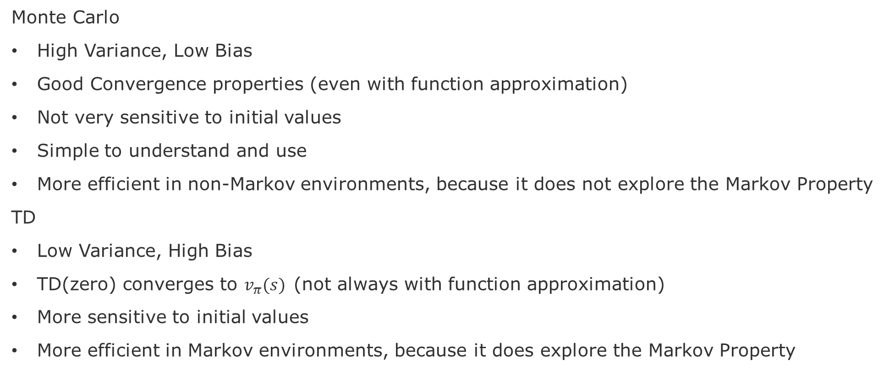
Summary of pros and cons
Monte Carlo
High Variance, Low Bias
Good Convergence properties (even with function approximation)
Not very sensitive to initial values
Simple to understand and use
More efficient in non-Markov environments, because it does not explore the Markov Property
TD
Low Variance, High Bias
TD(zero) converges to $v_{π}(s)$(not always with function approximation)
More sensitive to initial values
More efficient in Markov environments, because it does explore the Markov Property

Slide 30
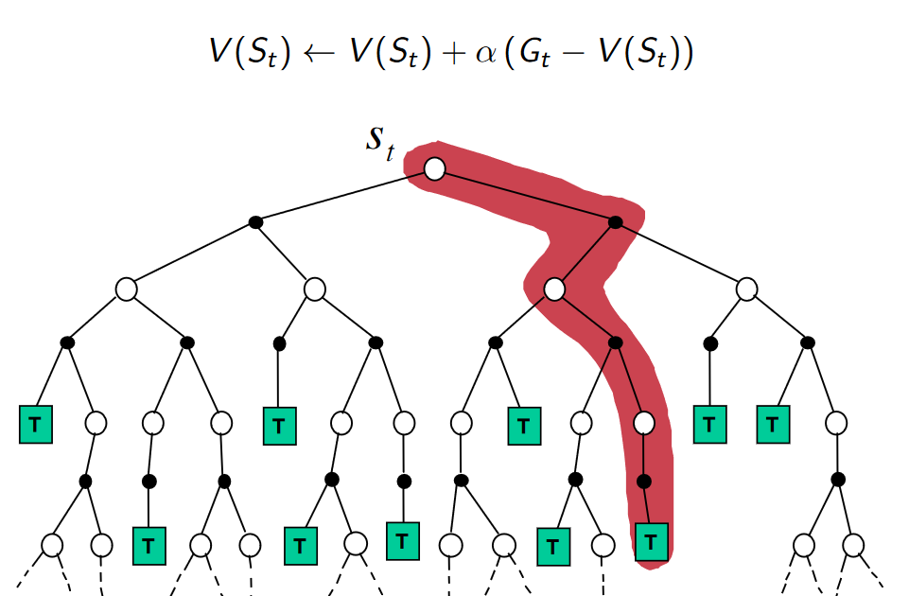
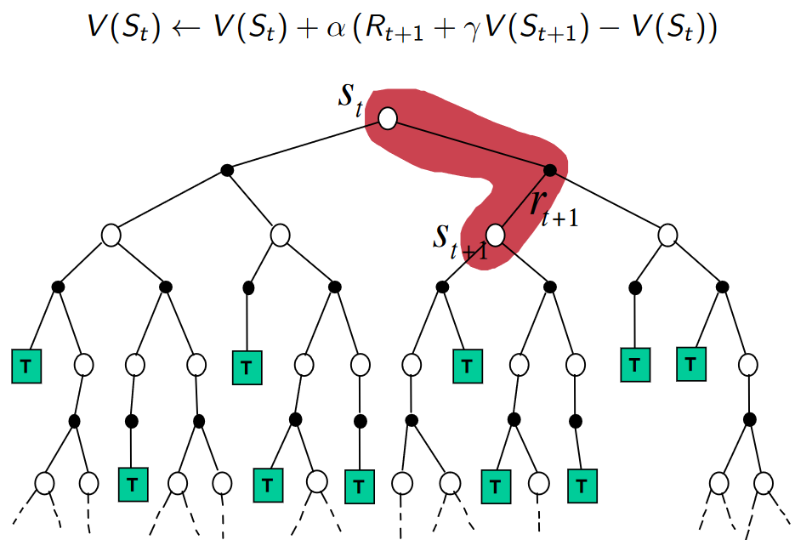
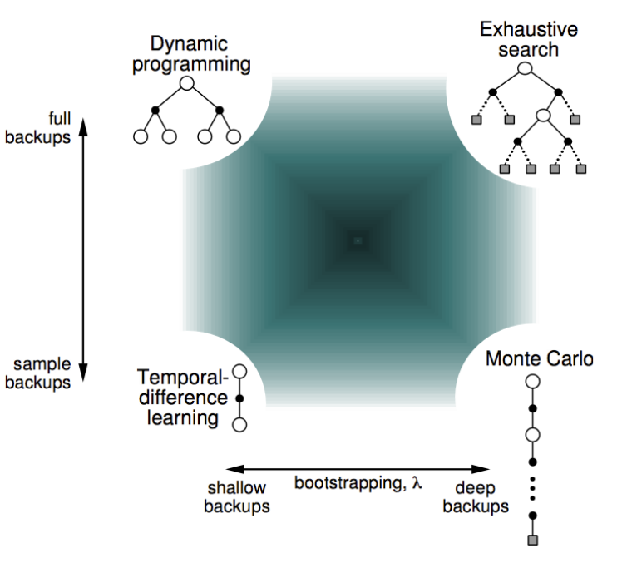
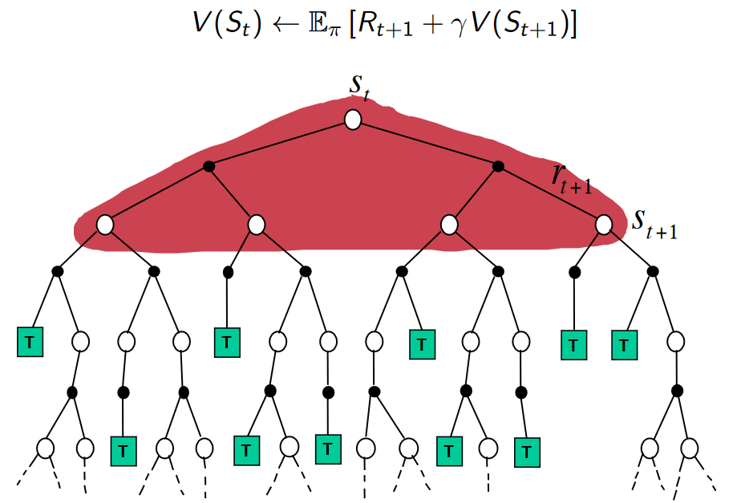
Comparing the three models
Monte Carlo
Temporal Difference
Bootstrapping: updating = to estimate
MC does not bootstrap
DP and TD bootstrap
Sampling: updating = to sample an expectation
MC and TD sample
DP does not sample
Dynamic programming

Slide 31
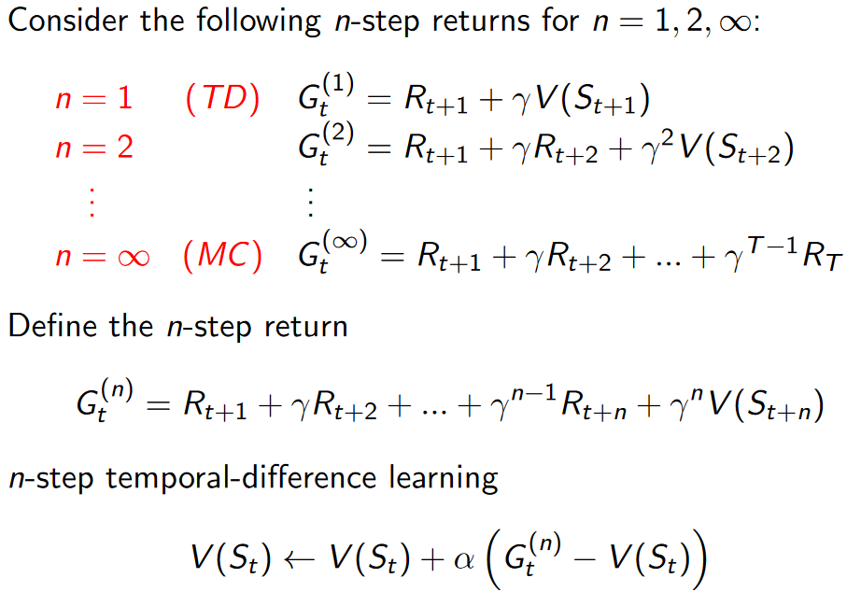
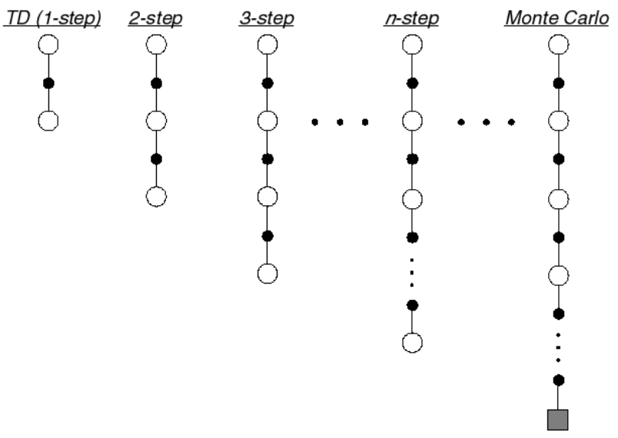
Trade-off between TD(0) and MC = TD(lambda)
Which n-value is the best?
Alpha = Learning rate
Gamma = Discount rate

Slide 32
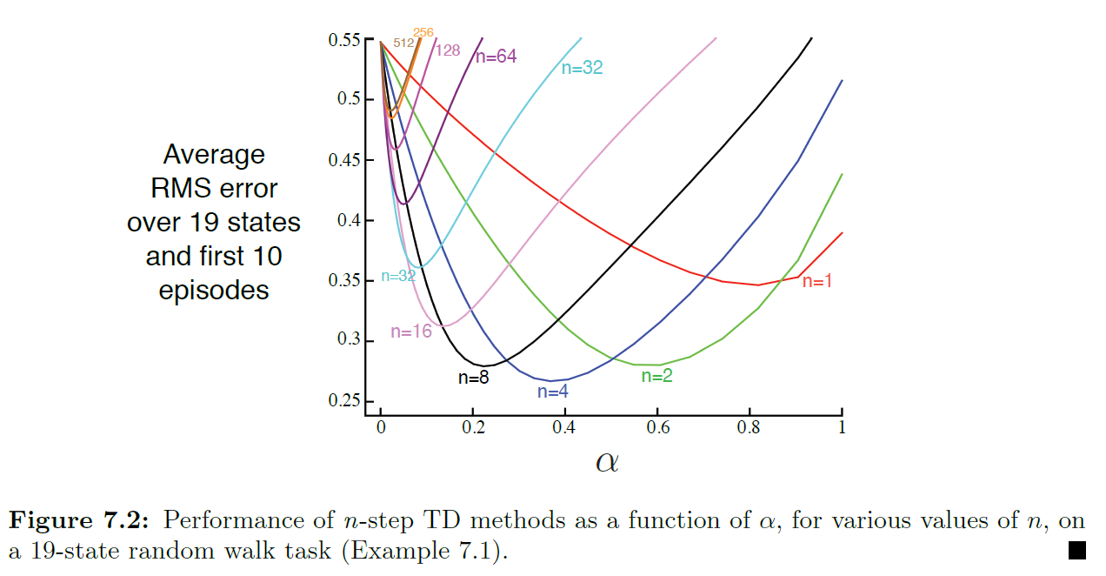
TD(λ) Which n value is the best?

Slide 33
Control Improving the policy to find optimal value-function

Slide 34
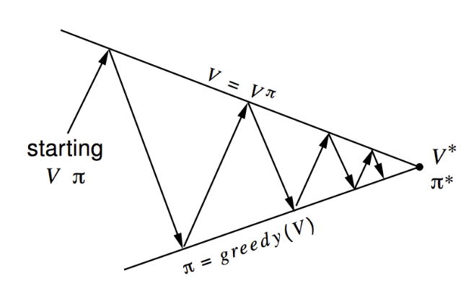
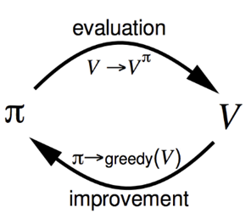
Generalized Policy Iteration
Convergence
ϖ* ==V*
Policy Evaluation:
What? estimates V^{ϖ}
How? Iterative policy evaluation
Policy Improvement:
What? generates a ϖ’ ≥ ϖ
How? Greedy policy improvement
Variations to these components:
Monte Carlo Evaluation
epsilon-Greedy (fixed exploration rate)
Monte Carlo GLIE (decaying exploratoin rate)
TD(0) and TD(lambda)
Notes:
We will vary these two components.

Slide 35
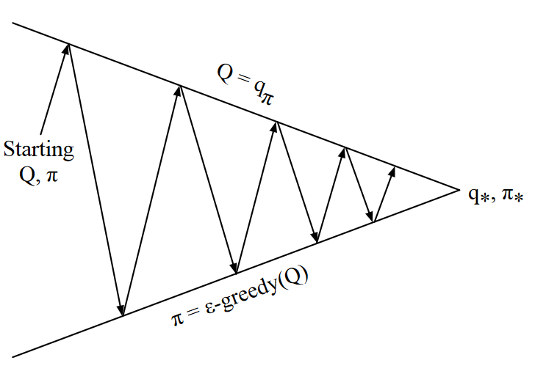
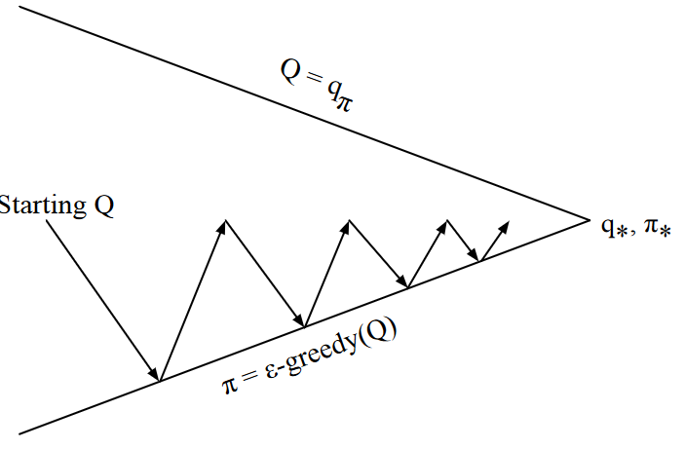

Monte Carlo Control
Solution part-1: use Q because it is based on state, action pairs
$$v^{k+1}\left(s\right)=\max_{a ∈A}\left(R^{a}+γP^{a}v^{k}\right)$$
No guarantee that will find the optimum
Control
for-loop:
Solution part-2: add randomness in the choice of action (e-Greedy)
Prediction

Slide 36

GLIE Monte Carlo Control
GLIE – Greedy in the Limit with Infinite in the limit Exploration
Decays epsilon, for instance ε
$ε=\frac{1}{k}$, where k is the episode count
All <state,action> pairs are explored indefinitely
$$\lim_{k→∞}N_{k}\left(s,a\right)= ∞$$
The policy ϖ converges to a greedy policy
$$\lim_{k→∞}{π_{k}\left(s,a\right)=I(a= \max_{a′}{q_{k}(s,a′)})}$$
Theorem shows that it also converges to the optimal value-function
$$\lim_{k→∞}{π_{k}\left(s,a\right)=I(a= \max_{a′}{q_{k}(s,a′)})}$$
Advantage: Converges to the optimal greedy policy
Caveat: Still expensive, even with partial episodes

Slide 37

On-Policy versus Off-Policy Control
On-Policy
Learn on the job
How? Learn about policy $π$ from experience sampled from $π$
Off-Policy
Look over someone else’s shoulder
How? Learn about policy $π$ from experience sampled from the environment

Slide 38





Sarsa: On-Policy TD Control
Advantage: Converges to the optimal greedy policy
Caveat: Still expensive, even with partial episodes

Slide 39

Q-Learning: off-policy TD Control
Choose among all possible actions

Slide 40
Comparing Sarsa and Q-Learning
Q-Learning does not follow any given policy to update the Q-value
However, Q-Learning still follows a “behavioral” policy in order to determine which state-action pairs to visit

Slide 41

Trade-off between Sarsa and Q-Learning
Gridworld example from [Sutton & Barto 2018] page 132.
Goal: is to go from S to G avoiding the Cliff.

Slide 42


N-Step Sarsa TD(λ)

Slide 43
Project-3 description

Slide 44
Markov Decision Process Model
Apply repair (pop top of stack)
C.1
Reorder repair (swap stack items)
B.1
B.1
Terminal State
A.1
B.1
Swapped item
B.1
C.1
C.1
C.1
B.1
C.1
A.1
A.1
A.1
Final Reward = Σ Intermediate Rewards
C.1
C.1
A.1
C.1
B.1
B.1
A.1
A.1
A.1
B.1

Slide 45
Project-3 tasks
Goal:
Integrate HMM model to the existing environment
Substitute the static transition matrix for the ones that you learned in Project-2
Run the existing implementation
Q-Learning and Sarsa
Discuss the Convergence Charts produced for
Different failure traces
Different HMM transition matrices

Slide 46
Main components
Environment
Environment interface (based on [1])
https://github.com/hpi-sam/rl-4-self-repair/blob/master/envs/data_handler.py
Our example:
https://github.com/hpi-sam/rl-4-self-repair/blob/master/envs/Playground_BrokenComponentsEnv.ipynb
List of failures (initial state):
https://github.com/hpi-sam/rl-4-self-repair/blob/master/envs/broken_components.py
Transition matrix to be substituted
https://github.com/hpi-sam/rl-4-self-repair/blob/master/data/transition_matrix/transition.py
Agent
Q-Learning
Sarsa
https://github.com/hpi-sam/rl-4-self-repair/blob/master/qlearning_nb.ipynb
[1] OpenAI Gym - https://gym.openai.com/

Slide 47
Interesting lectures
David Silver, 2015, University College London Lecture 1 https://www.youtube.com/watch?v=2pWv7GOvuf0 Lecture 2 https://www.youtube.com/watch?v=lfHX2hHRMVQ&list=PLqYmG7hTraZDM-OYHWgPebj2MfCFzFObQ&index=2&pbjreload=10 Lecture 3 https://www.youtube.com/watch?v=Nd1-UUMVfz4&list=PLqYmG7hTraZDM-OYHWgPebj2MfCFzFObQ&index=3&pbjreload=10 Course website: https://www.davidsilver.uk/teaching/ | Bottom-up explanations based on introducing the simpler models before adding the complexity that justify more complex models. Explains the math behind concepts.
Pascal Poupert, 2018, University of Waterloo, Canada Lecture 1b: https://www.youtube.com/watch?v=yOWBb0mqENw&list=PLdAoL1zKcqTXFJniO3Tqqn6xMBBL07EDc&index=2&pbjreload=10 Lecture 2a: https://www.youtube.com/watch?v=yOWBb0mqENw&list=PLdAoL1zKcqTXFJniO3Tqqn6xMBBL07EDc&index=2&pbjreload=10 Lecture 2b: https://www.youtube.com/watch?v=mjyrRG7RD84&list=PLdAoL1zKcqTXFJniO3Tqqn6xMBBL07EDc&index=5&pbjreload=10 Course website: https://cs.uwaterloo.ca/~ppoupart/teaching/cs885-spring20/schedule.html | More conceptual level with examples of applications.
Charles Isbell & Michael Littman, 2015, Georgia Tech https://www.youtube.com/watch?v=rETmf4NnlPM&list=PL__ycckD1ec_yNMjDl-Lq4-1ZqHcXqgm7&index=128&pbjreload=10 | Step-by-step explanations with fun discussions and lot of small examples to illustrate each core MDP principle
Nando Freitas, 2015, Lectures Oxford University, UK Lecture 15 https://www.youtube.com/watch?v=kUiR0RLmGCo Lecture 16 https://www.youtube.com/watch?v=dV80NAlEins Course Website: https://www.cs.ox.ac.uk/people/nando.defreitas/machinelearning/ | Lectures in the context of Deep Learning, but still provide the necessary concepts of RL.

Slide 48
End

Slide 49
Incremental implementations
Budget
Infinite
Finite
Model-Based
Model-Free
Finite
State Space
Model-Free or
Approximate
Approximate
Infinite

Slide 50
Supervisory Component

